Slide 1
This Week Work Progress
Lecturer：SUSTech Li Yuchen
2019.1.24

Slide 2
content
01
Reading Code & Recurring paper
02
Migrating to DR data set
03
Studying machine learning & Tensorflow

Slide 3
Reading paper & Recurring paper
Part One
01

Slide 4
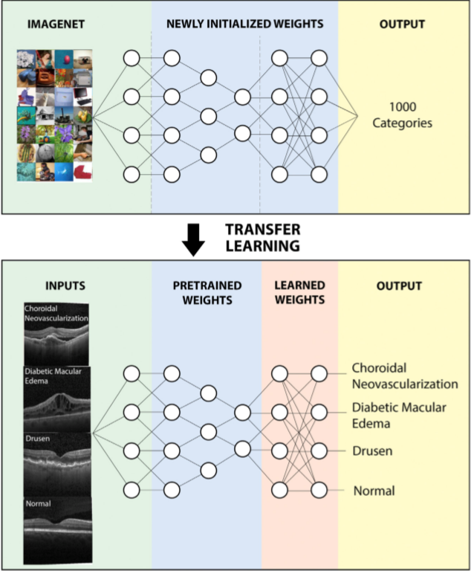
Cell: Identifying Medical Diagnoses and Treatable Diseases by Image-Based Deep Learning

Slide 5
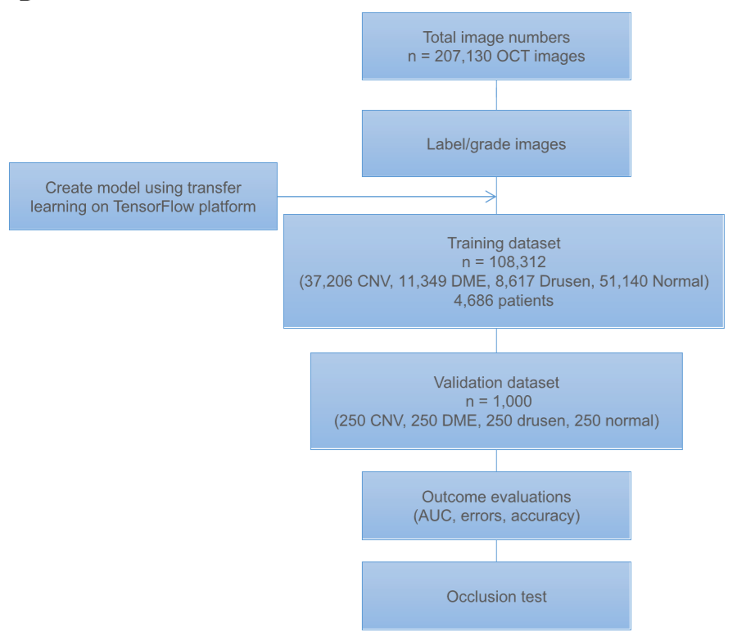
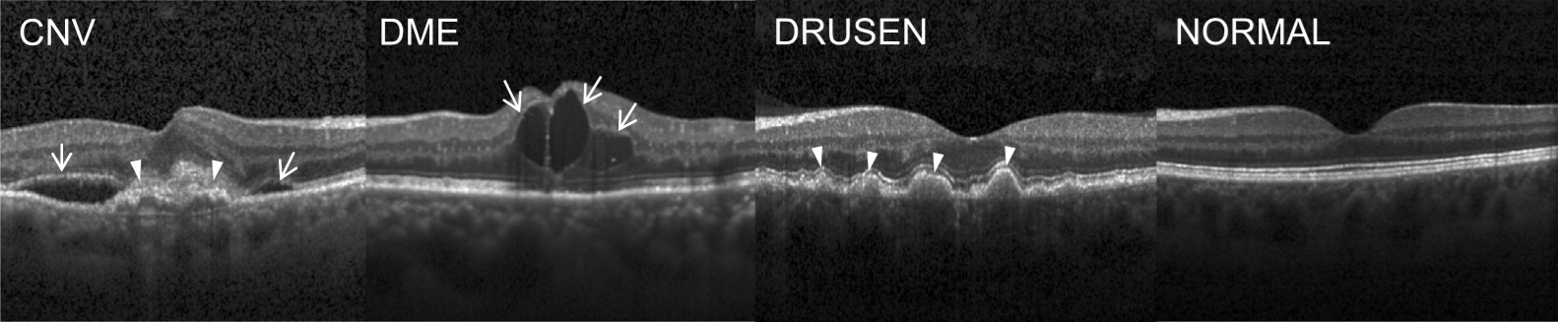
Macular Degeneration and Diabetic Retinopathy（OCT）
age-related macular degeneration
XRray
training：Normal：1349
PNEUMONIA：3884
test：Normal：234
PNEUMONIA：390
age-related macular degeneration
age-related macular degeneration
CNV: Choroidal Neovascularization 脉络新生血管
DME: Diabetic macular edema 糖尿病性黄斑水肿
DRUSEN: Multiple drusen present in early AMD
(age-related macular degeneration)

Slide 6
Migrating to DR data set
Part Two
02

Slide 7
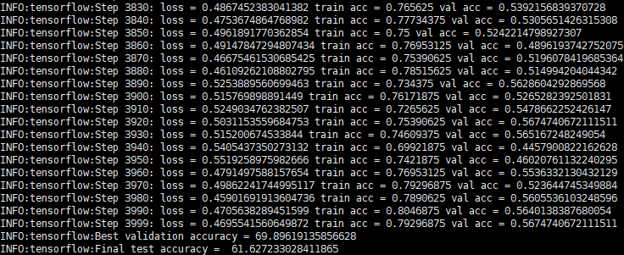
Migrating to DR data set
DR! let: 1259 right：1348 all: 2607

Slide 8
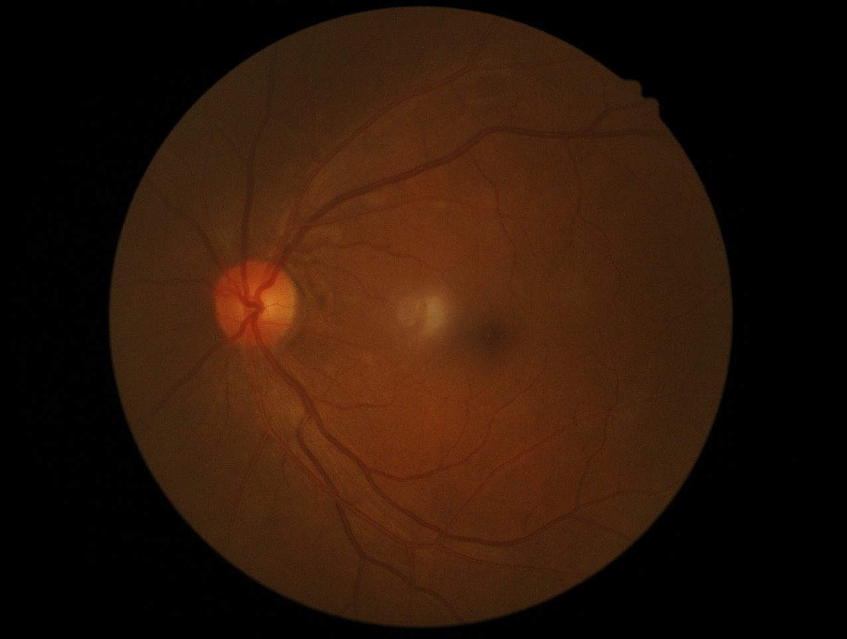
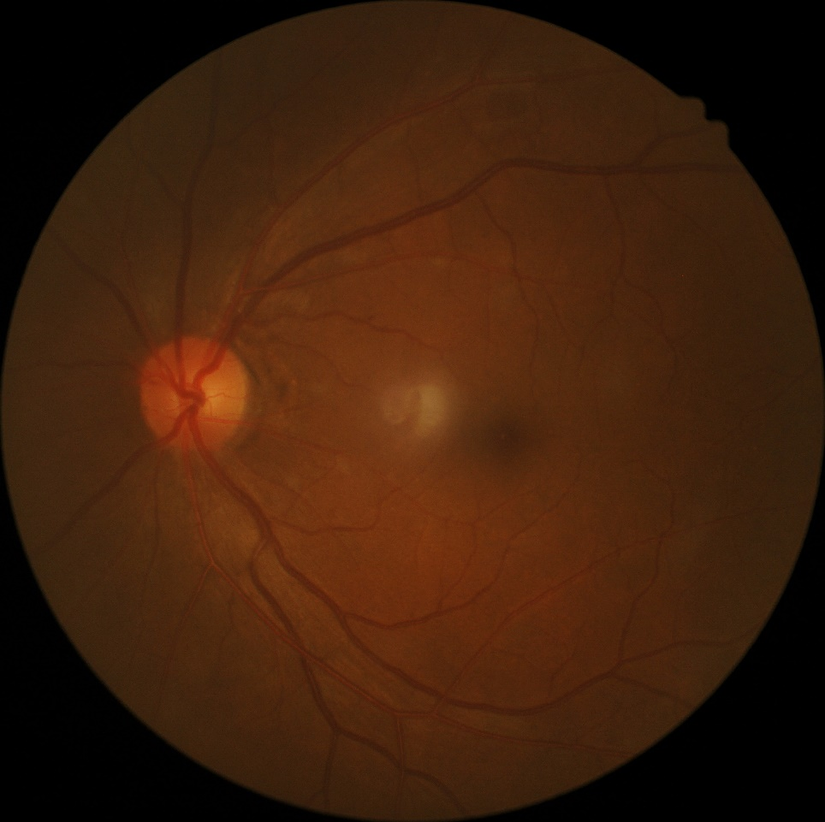
Remove the black edge of the image

Slide 9
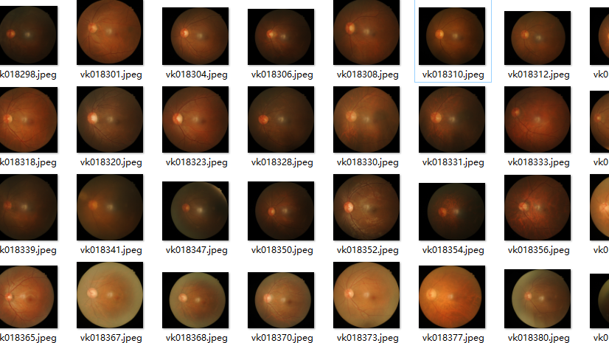
Problems
Best validation accuracy = 58.95237922668457
Final test accuracy = 50.67698359489441

Slide 10
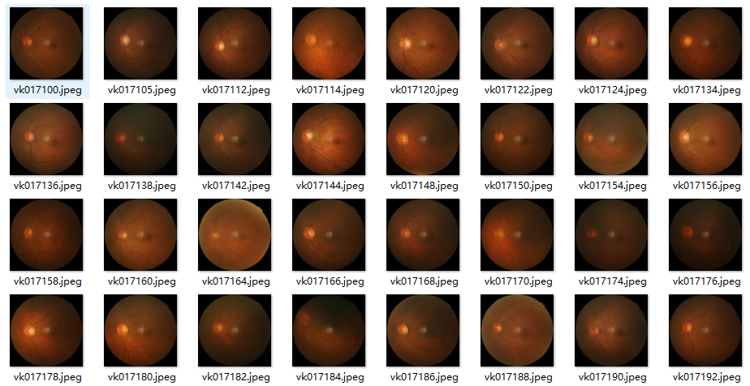
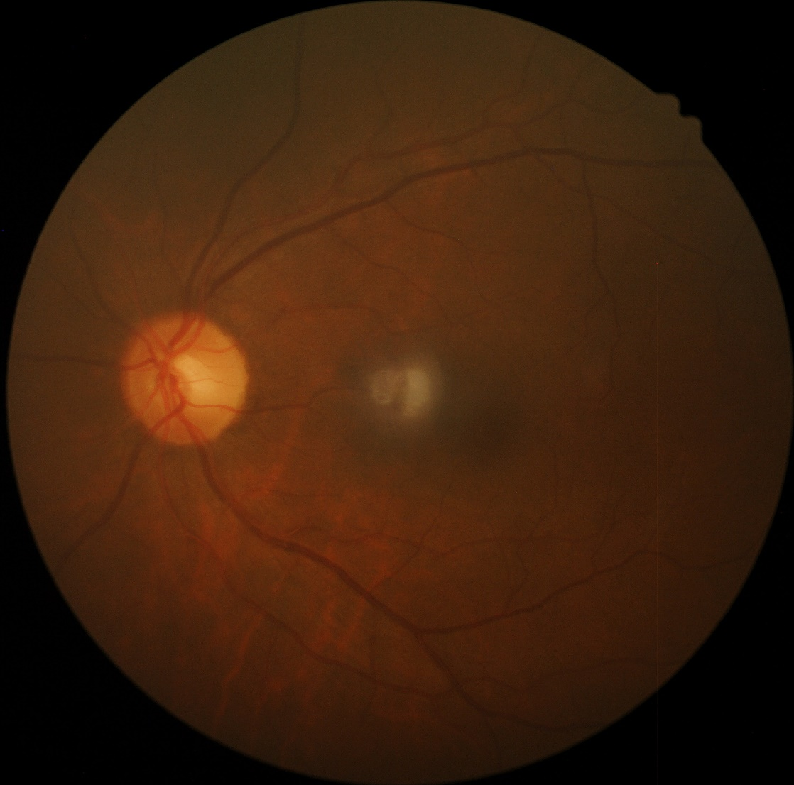
Unified the Size of Segmentation
According to 500 images average sizes to make a rectangle

Slide 11
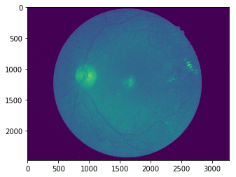
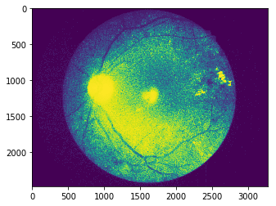
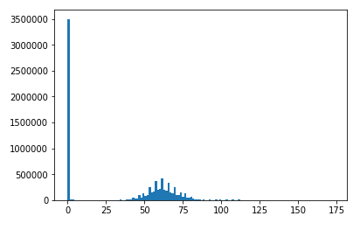
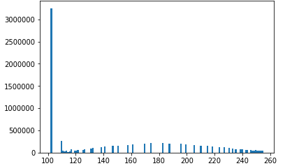
Some image processing of the picture
1、直方图均衡化

Slide 12
Study
Part Three
03

Slide 13
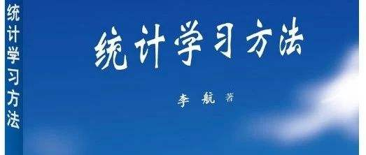
Reading Books
《Statistical Learning Method》 first seven chapters: perceptron, k-NN, naïve bayes, decision tree, logistic regression, SVM
《Andrew Ng，Machine Learning》 the ninth chapter
《Introduction to Tensorflow》do some experiment of the examples in the book

Slide 14
Future plan
01
Try to use Image enhancement
02
Add bounding box
02
Erosion and Dilation

Slide 15
THANKS
And Your Slogan Here.

